Slide 1


Movie Recommendation System
AI-Based Smart Genre Recommender using Live TMDb Data
Notes:
1

Slide 2
Project Team:
Name Enrollment Number
Khatik Prince Meghraj
2503842036
Mahajan Chirag Nemichand
2503942018
Patel Dharmik Maheshbhai
2501542073
Patel NishitKumar Bhaveshbhai
2501442081
Pawar Sumit Santosh
2503942028
Notes:
2

Slide 3



System Overview
AI-Powered Engine
Multi-Language Support
Smart Genre Detection
Intelligent recommendation system that analyzes movie content to deliver personalized suggestions based on genre preferences.
Fetches live data across English and major Indian languages including Hindi, Telugu, Tamil, Malayalam, and Kannada.
Uses keyword-based analysis of movie overviews for more accurate categorization than standard API genre tags.
Users simply input their preferred genre, and the system instantly outputs the top relevant movies from across multiple film industries.
Notes:
3

Slide 4

Project Objectives
Core Goals
Technical Targets
Build a smart genre-based movie recommender
Classify movies using overview-based keyword matching
Fetch real-time movie data from TMDb API
Deliver accurate recommendations beyond unreliable API tags
Support Hollywood and Indian movie industries
Display clean, organized lists of top movies per genre
Notes:
4

Slide 5
Implementation Details
01
02
API Integration
Data Collection
Used Python and Requests library to connect with TMDb API
Fetched movies across 6 languages (4 pages each) totaling ~480 movies
03
04
Data Cleaning
Genre Mapping
Removed duplicate entries using unique movie IDs
Created custom keyword sets for comedy, action, romance, horror, thriller, drama, sci-fi
05
06
Smart Detection
Result Display
Matched keywords within movie overview text for precise categorization
Returned top 50 unique movies per genre with continuous search capability
Notes:
5

Slide 6
How the Movie Recommendation System Works
This intelligent recommendation system delivers personalized movie suggestions by analyzing real-time data and understanding content through natural language processing.
01
02
Data Collection
Smart Analysis
Built in Python, the system connects to TMDb API to fetch live movie data across English and major Indian languages in real-time.
Rather than trusting potentially inaccurate genre tags, the system reads each movie's overview text to understand its true nature.
03
04
Keyword Matching
Personalized Results
A custom-built keyword library identifies genres like action, comedy, romance, thriller, and sci-fi from movie descriptions.
When you enter a genre, the system searches overviews for matching keywords and displays the most relevant films.
The result is a recommendation engine that understands movies through their actual content, not just metadata labels.

Slide 7


Why This Method Is Better
Traditional Approach
Our Smart Solution
Relies on pre-tagged genres
Analyzes actual movie descriptions
Inaccurate labels, especially for Indian cinema
Accurate across all film industries
Reliable, content-based matching
Inconsistent metadata quality
Live data stays current
Static, outdated information
Equal Treatment
Always Current
Hollywood and Indian films analyzed with the same standards, without relying on external metadata quality.
Live API integration ensures recommendations stay fresh and relevant with newly released content.
Future-Ready
Flexible architecture allows easy addition of new genres, keyword refinement, and logic enhancements.
By understanding movies through their actual content rather than potentially flawed tags, this system delivers more accurate and trustworthy recommendations.

Slide 8
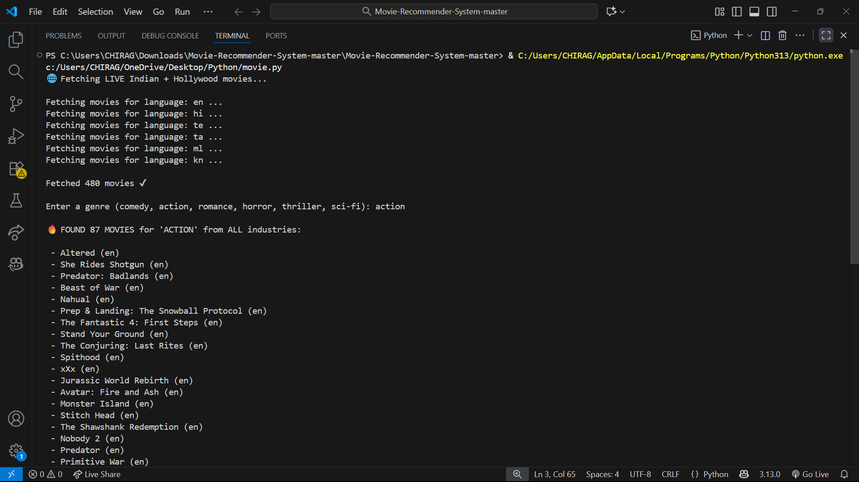
Output:

Slide 9


Results & Analysis
480+
6
7
Movies Fetched
Languages Supported
Genre Categories
Live data from multiple languages
Comprehensive keyword mapping
English plus major Indian languages
The system successfully retrieved live movie data across all selected languages. Genre filtering performed accurately using keyword-based matching in movie overviews. For each selected genre (e.g., Action), the system returns a curated list of relevant movies spanning Hollywood and Indian cinema.
Implementation Note: Insert terminal output screenshot here showing movie fetch results and genre-filtered movie lists.
Notes:
6

Slide 10

Conclusion
Key Achievements
The recommender delivers fast, reliable, and real-time genre suggestions that work seamlessly across multiple film industries. By implementing custom keyword matching, the system overcomes the limitations of poorly tagged Indian cinema in standard APIs.
Future Enhancements
ML-based similarity scoring for deeper analysis
User profile integration for personalized recommendations
Advanced deep learning models for content understanding
Notes:
7

Slide 11

Thank You!
Questions?
Notes:
8

